Slide 1

Review-2
Smart Healthcare System using AI and Blockchain for Heart Disease
Project Guide
MR. Y. DURGA PRASAD
M. Tech(PhD), Associate Professor
Submitted by
Shakthi Vamsi – 22MH1A0547
Sombabu Patel – 22MH1A0569
Sujal Sourav – 22MH1A0570
Ayyappa Reddy – 22MH1A0571

Slide 2
INDEX
1. Abstract
2. Introduction
3. Objectives
4. Existing System
5. Proposed System
Comparative Table
Features of the proposed system
System Architecture
Tech Stack used
UML Diagrams
Findings from Reference Papers
Applications of the Project
Novelty and Innovation
Implementation Details & Roadmap
References

Slide 3
Abstract
This project presents a Smart Healthcare System that integrates Artificial Intelligence (AI) and Blockchain technologies to enhance healthcare services. The system employs a machine learning model for accurate heart disease prediction using patient health data, enabling early diagnosis and preventive care. To ensure data integrity and security, a blockchain-based architecture is implemented for storing medical records, making them tamper-proof and verifiable. Additionally, the system supports remote healthcare through a simple telemedicine interface, allowing patients to consult doctors and access their reports securely. By combining intelligence, transparency, and accessibility, the proposed system addresses critical challenges such as delayed diagnosis, insecure medical data handling, and limited access to healthcare in remote areas.

Slide 4
Introduction
Healthcare systems today face challenges such as delayed diagnosis, record manipulation, and limited access to medical services, particularly in rural areas. This project presents a Smart Healthcare System integrating Artificial Intelligence (AI) for heart disease prediction and Blockchain technology for secure, tamper-proof medical records. The system aims to improve diagnosis accuracy, data security, and remote healthcare accessibility through telemedicine. By combining intelligence, transparency, and accessibility, the proposed system addresses key healthcare issues and demonstrates how emerging technologies can enhance patient care and trust in digital health solutions.

Slide 5
Objectives
To predict heart disease using machine learning algorithms for early detection and prevention..
To ensure secure medical data storage and integrity through the implementation of blockchain technology..
To enable remote doctor–patient consultations using a telemedicine platform for improved accessibility..
To enhance trust, accessibility, and efficiency within the healthcare system by integrating AI and blockchain technologies..

Slide 6
Existing System
Existing healthcare systems often rely on centralized data storage, which increases the risk of data tampering, unauthorized access, and data loss. Many existing predictive models focus only on disease detection but lack secure and transparent data handling mechanisms. Similarly, traditional telemedicine platforms provide remote consultation but do not guarantee patient data confidentiality or integrity. As a result, patients face challenges in maintaining trust, data security, and accessibility in healthcare services.
Technologies Used: Conventional relational databases, and MediSoft standard web-based interfaces for storing patient details.

Slide 7
Proposed System
The proposed system integrates Artificial Intelligence (AI) for heart disease prediction with Blockchain technology for secure medical record management. The AI model analyzes patient health data to predict the likelihood of heart disease, enabling early detection and preventive care. Once a diagnosis is generated, the results are securely stored on the blockchain, ensuring data integrity, transparency, and tamper-proof access.
Patients can view their reports verified through blockchain, while doctors can access these records to provide accurate consultations. The system also includes a telemedicine interface that enables real-time communication between doctors and patients through chat or video calls, improving accessibility and convenience.
System Flow:
Input Data → AI Model → Prediction → Blockchain Record → Telemedicine Interface

Slide 8
Comparative Table
Feature | Existing System | Proposed System
Data Security | Low (Centralized) | High(Decentralized)
Accessibility | Limited | Telemedicine
Diagnosis | Manual | Prediction
Data Integrity | Vulnerable | Tamper-Proof
Transparency | Low | High

Slide 9
Features of the Proposed System
1. AI Prediction (risk level, score)
2. BMI & Symptom Checker
3. Blockchain-secured medical records
4. QR verification & transaction history
5. Telemedicine: login, booking, chat
6. Dashboard: graphs, tips, PDF reports
7.Digital Twin
8.Cross Hospital Data Access
9.Real Time Notification Alert
10.Consent Management

Slide 10
System Architecture
User Interface (React Web Application) – Patient enters health parameters – Doctor views reports and verification – Admin manages system
AI Prediction Layer – Logistic Regression model – Calculates disease risk probability
Backend Services – Authentication and user management – Stores predictions and reports – Notification service
Blockchain Verification Layer – Generates SHA-256 hash of report – Stores hash in ledger table – QR-based verification
Database – Patient data – Prediction history – Ledger transactions
Flow: User Input → AI Model → Prediction → Hash Generation → Ledger Storage → Verification

Slide 11
Dataset Description
Dataset Used – Heart Disease Dataset
Dataset Name: UCI Cleveland Heart Disease Dataset
Source: UCI Machine Learning Repository (Kaggle)
https://www.kaggle.com/datasets/ronitf/heart-disease-uci
Number of Records: ~303 patient samples
Number of Features: 13 medical attributes

Slide 12
Sample Attributes:
Age
Sex
Chest Pain Type
Resting Blood Pressure
Cholesterol
Fasting Blood Sugar
ECG Results
Maximum Heart Rate
Exercise Induced Angina
BMI
Target Column:
0 → No Heart Disease
1 → Heart Disease
Data Preprocessing:
Removal of missing values
Normalization
Encoding categorical features
Feature selection

Slide 13
Machine Learning Model
Algorithm Used: Decision Tree Classifier
Type: Supervised Machine Learning Algorithm
Purpose: Binary Classification
Working Principle:
Splits data based on feature conditions
Forms tree structure of decisions
Uses Gini Index / Information Gain
Output:
Class prediction (Disease / No Disease)
Probability score
Advantages:
Easy to understand and visualize
Rule-based prediction
Handles non-linear data
No complex math required
• Used in healthcare decision support systems

Slide 14
How Decision Tree Works
.Dataset is loaded into the system
Input features and target label are separated
Algorithm selects best feature for root node
Data splits based on feature thresholds
Tree grows until stopping criteria
Each leaf node gives final prediction
New patient data passes through the tree
Path of rules leads to prediction result
Example :
If Age > 50
→ If Cholesterol > 240
→ High Risk
→ Else
→ Medium Risk
Else
→ Low Risk

Slide 15
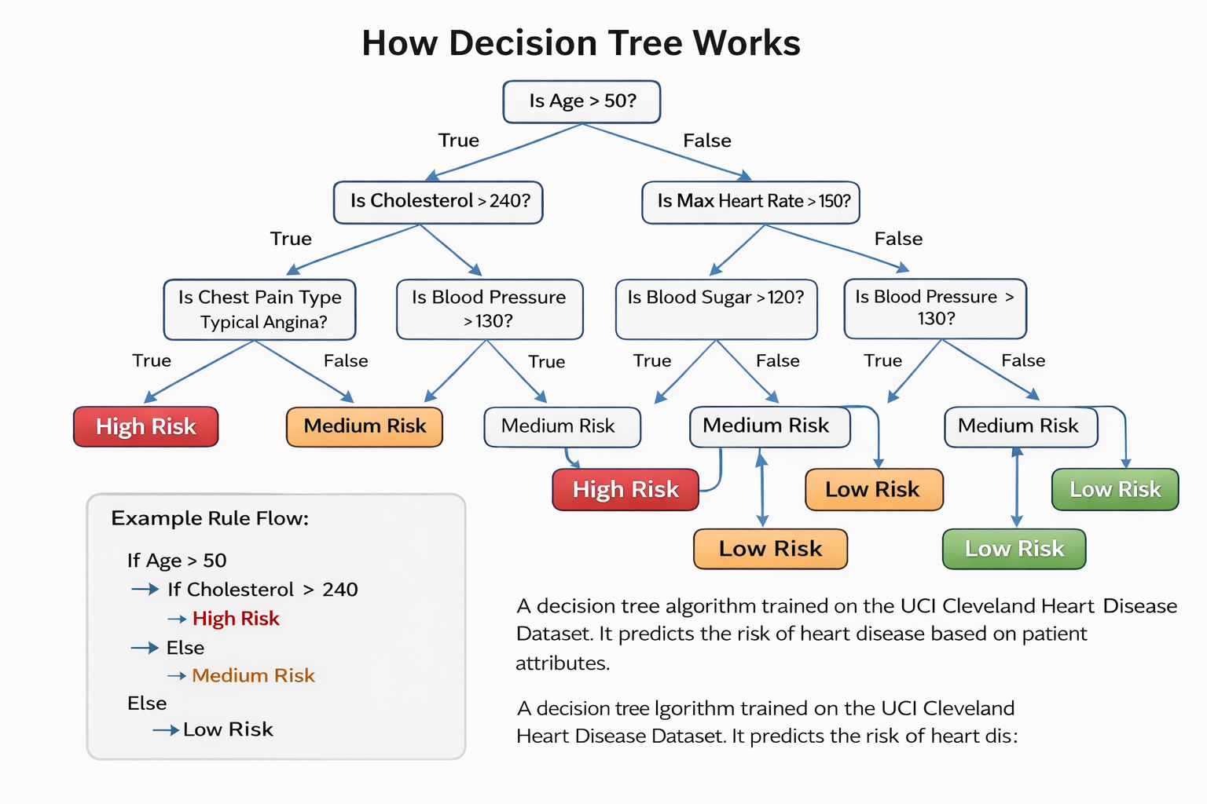

Slide 16
Model Prediction Flow
Patient Input → Feature Selection → Decision Tree Rules → Risk Classification → Result Display → Blockchain Storage
• Model evaluates each input feature • Follows rule path in tree • Generates disease prediction • Converts result into risk category

Slide 17
Type of Blockchain Is Used
Private Permissioned Blockchain
• The system uses a private blockchain, not a public blockchain like Bitcoin or Ethereum. • Only authorized users (doctors, patients, admins) can access the ledger. • Transactions are controlled inside the application backend. • It is implemented as a ledger table with cryptographic hash chaining. • Suitable for healthcare because patient data must remain confidential.

Slide 18
Blockchain Integration
Patient Prediction → Hash Generation → Ledger Storage → Transaction ID → QR Code → Verification Page → Hash Comparison → Integrity Confirmation

Slide 19
Tech Stack Used
AI/ML: Python, Scikit-learn, Pandas, NumPy, Decision Tree Classifier
Dataset: UCI Cleveland Heart Disease
Backend: Flask, Postman, Authentication, Database APIs
Blockchain: SHA-256 Hashing, Ledger Table (Hash Chaining), QR Code Verification
Frontend: React.js, TypeScript, Tailwind CSS
Database: PostgreSQL
Tools: VS Code, GitHub

Slide 20
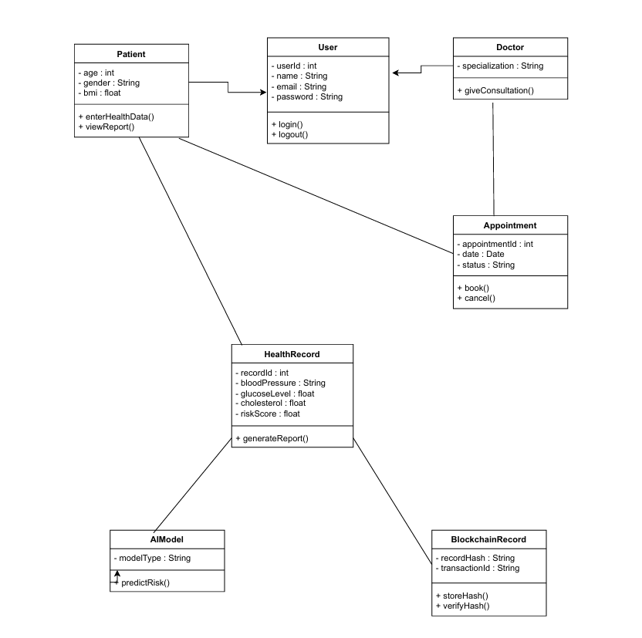
Structural Diagrams
Class Diagram

Slide 21
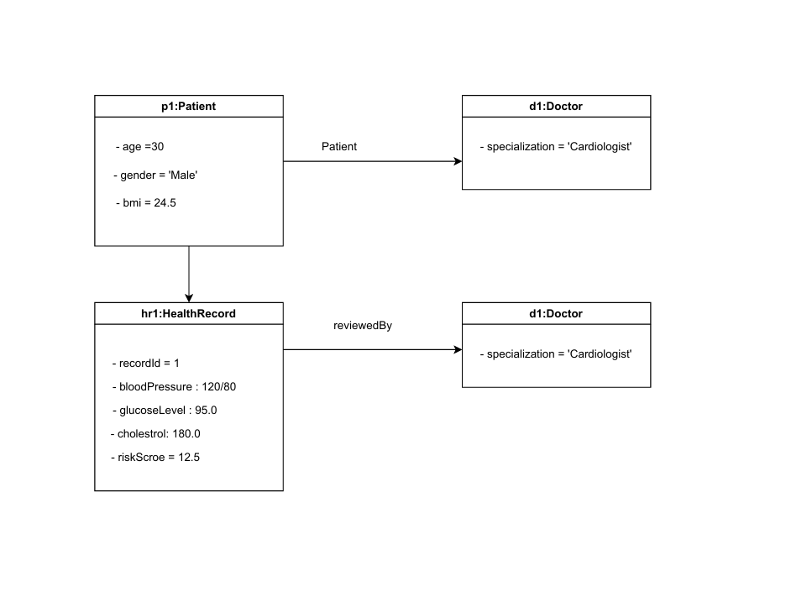
ii. Object Diagram

Slide 22
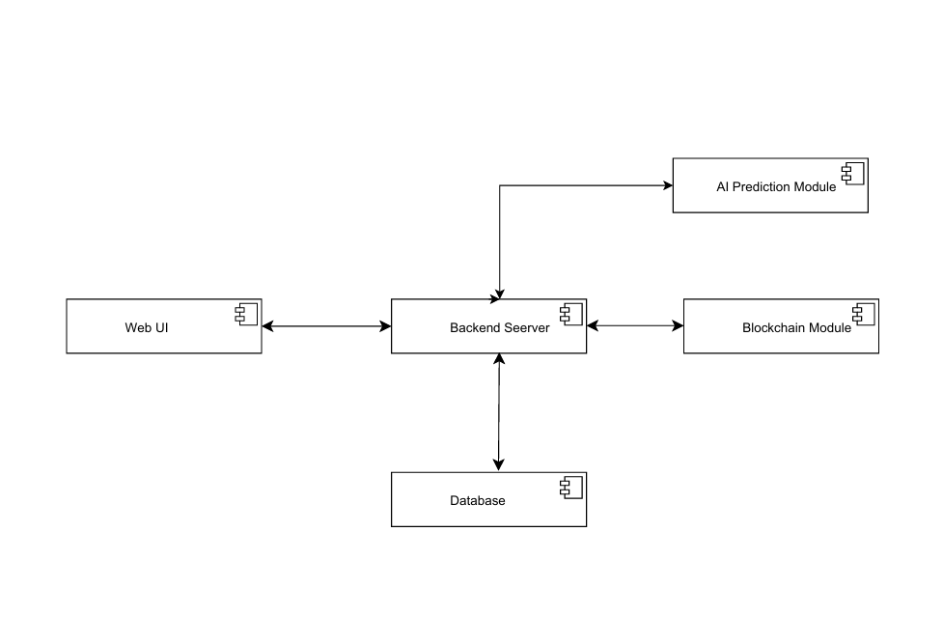
iii. Component Diagram

Slide 23
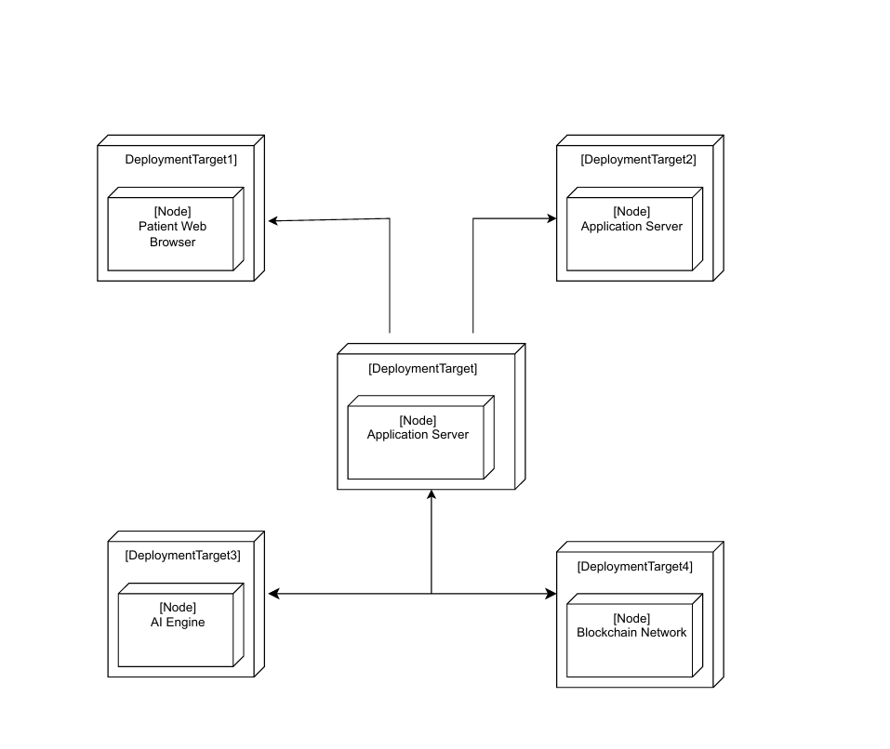
iv. Deployment Diagram

Slide 24
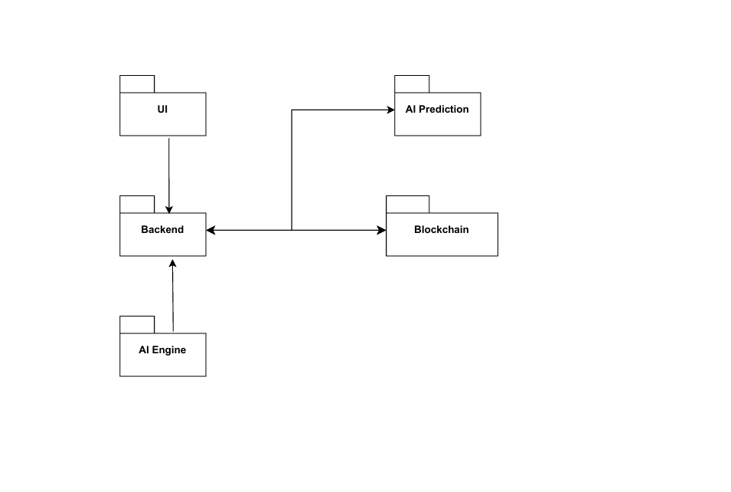
v. Package Diagram

Slide 25
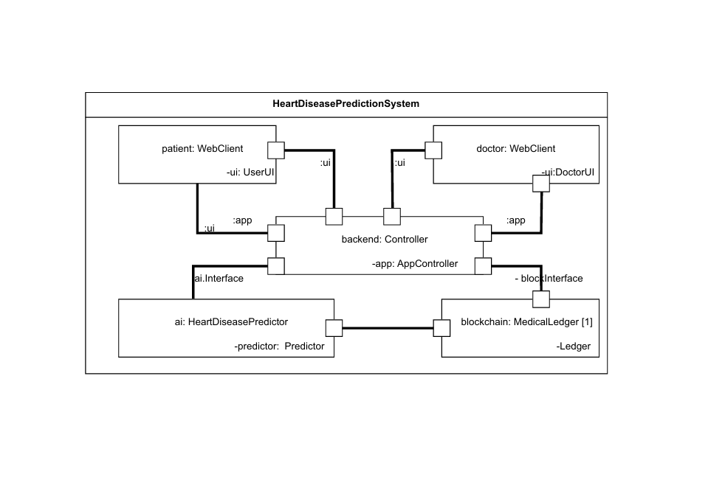
vi. Composite Structure Diagram

Slide 26
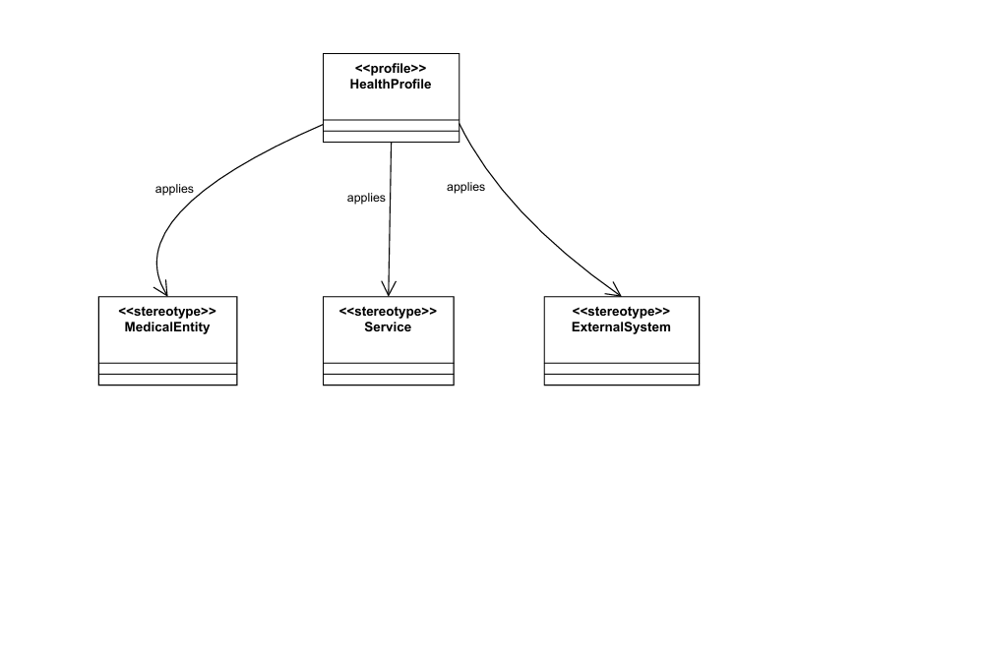
vii. Profile Diagram

Slide 27
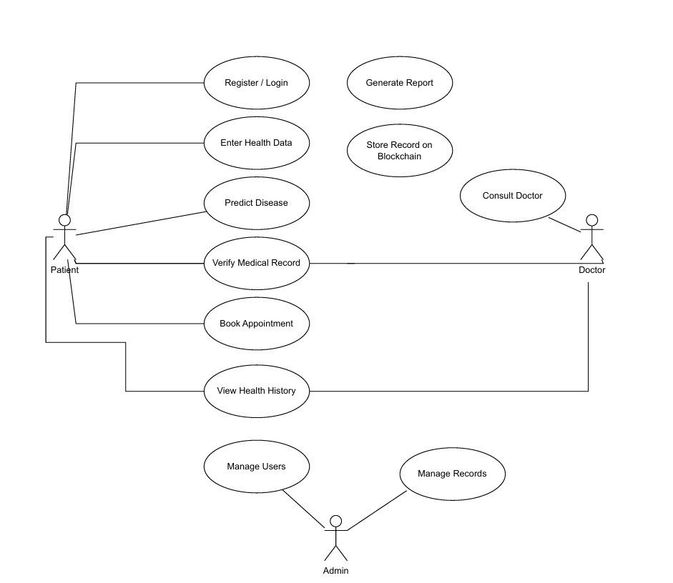
Behavioral Diagram
Use Case Diagram

Slide 28
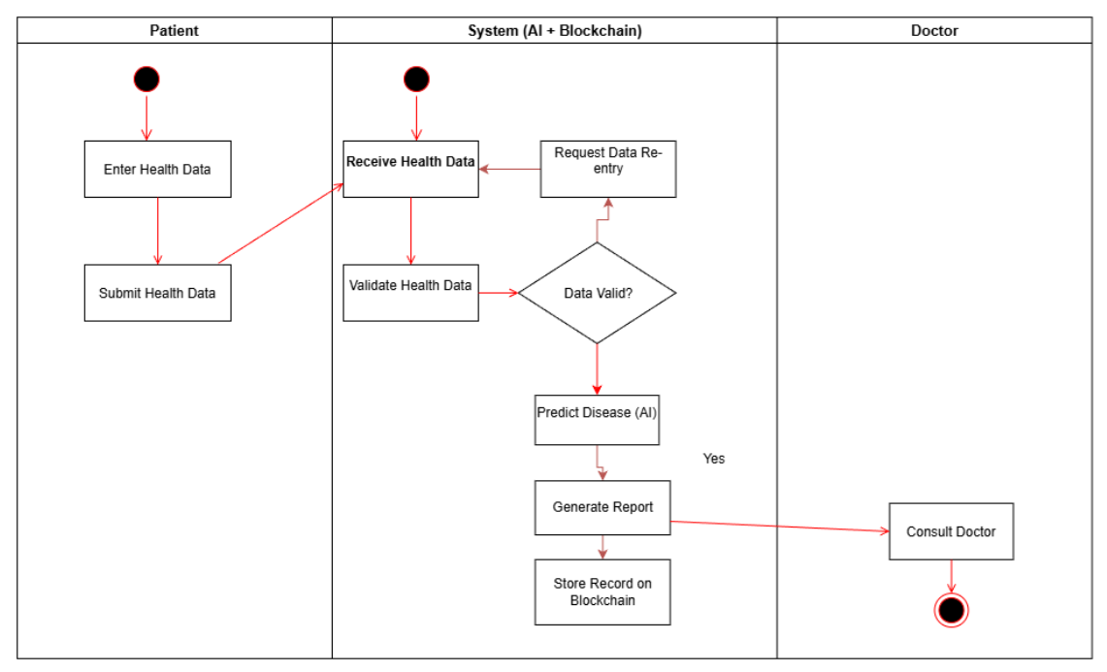
ii. Activity Diagram

Slide 29
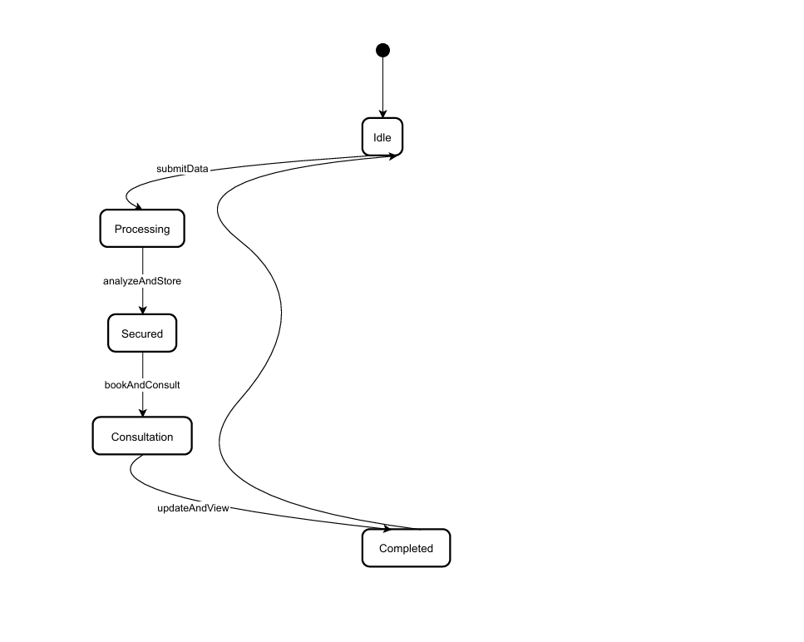
iii. State Machine Diagram

Slide 30
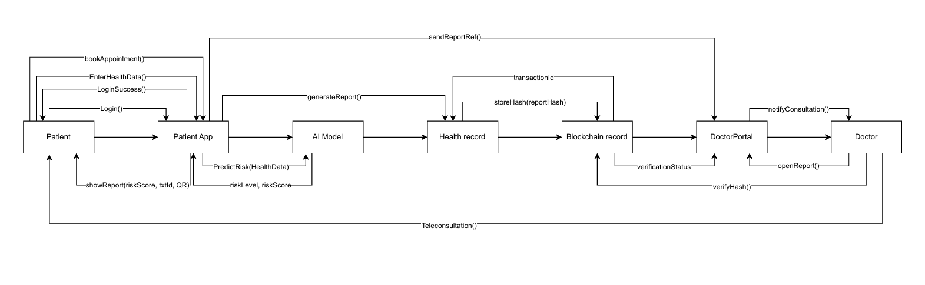
iv. Sequence Diagram

Slide 31
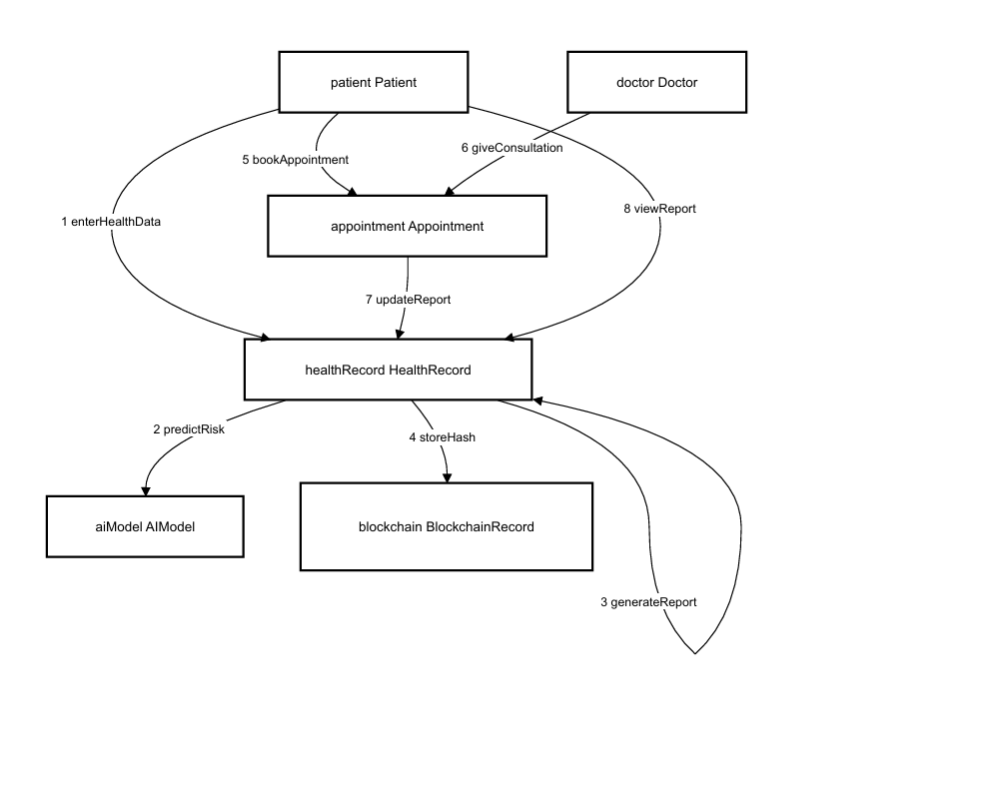
v. Communication Diagram

Slide 32
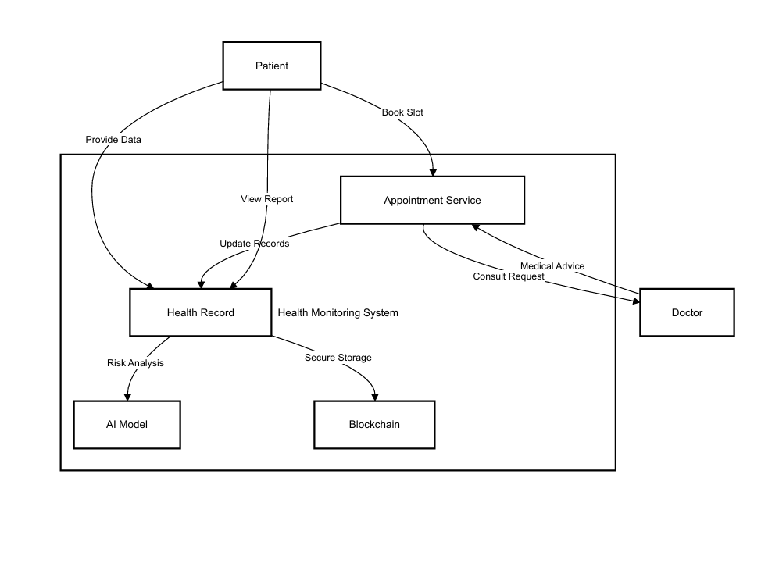
vi. Interactive Overview Diagram

Slide 33
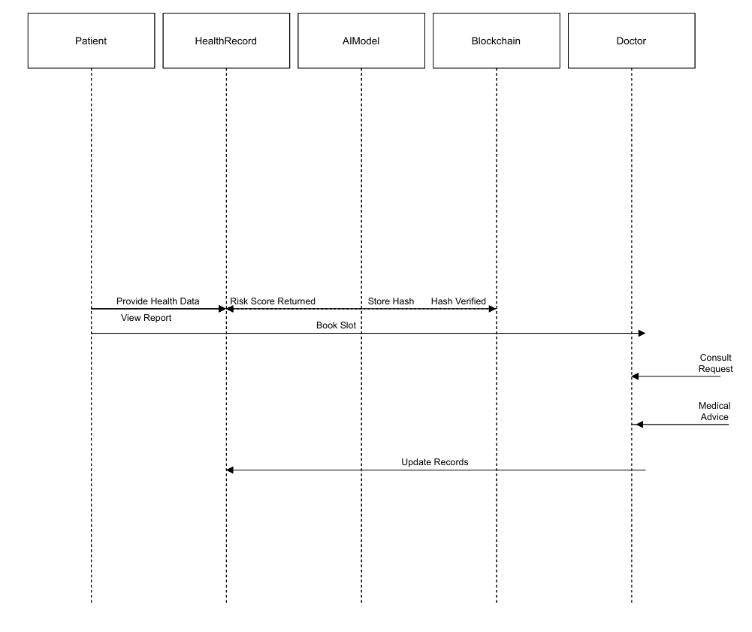
vii. Timing Diagram

Slide 34
Implementation Details & Roadmap
Phase 1 (Week 1–4): Research, dataset collection, and architecture design.
Phase 2 (Week 5–8): AI model development for heart disease prediction.
Phase 3 (Week 9–12): Blockchain integration for secure record storage.
Phase 4 (Week 13–16): Telemedicine and frontend integration.
Tools: Python, Flask, Scikit-learn, Ethereum (Ganache), React, MongoDB.

Slide 35
Findings from Reference Papers
Several research studies highlight the effectiveness of Artificial Intelligence (AI) in accurately predicting cardiovascular diseases using patient data and medical parameters. These studies demonstrate that machine learning algorithms can significantly improve early diagnosis and treatment planning. Similarly, numerous papers emphasize the potential of Blockchain technology to enhance the security, transparency, and integrity of medical records.
The integration of AI and Blockchain, as discussed in recent research, presents a novel and trustworthy approach to modern healthcare. This combination not only improves diagnostic accuracy but also ensures secure, tamper-proof data management, thereby increasing patient trust and overall healthcare efficiency.

Slide 36
References
1. Heart Disease UCI Dataset - Kaggle. (https://www.kaggle.com/datasets/redwankarimsony/heart-disease-data)
2. IEEE Papers on AI in Healthcare.(https://ieeexplore.ieee.org/document/9441741)
3. Blockchain Technology Documentation.(https://blockchain.gov.in/Home/BlockChain?blockchain=blockchain)
4. Research articles on AI-based health prediction models.(https://pmc.ncbi.nlm.nih.gov/articles/PMC12525484/)

